Slide 1

HR Report Analysis

Slide 2
Overview
This HR report analysis was conducted using SQL queries to extract, transform, and summarize employee data from the company's HR database. The dataset contained 22,214 records across 13 attributes, including employee demographics, department, job title, location, hire date, and termination date.

Slide 3
Methodology
Data Extraction: SQL queries were written to retrieve relevant fields such as employee ID, age, gender, race, department, job title, location, and hire year.
KPI Calculation: Queries were used to calculate total employees, percentage of employees working at Headquarters vs. Remote, and average age.
Trend Analysis: Hiring rate by year was derived using aggregation functions on the hire date column.
Demographic Distribution: Donut and bar chart data were generated by grouping employees by gender, state, department, and race.
Visualization: The outputs of these SQL queries were imported into Power BI/Tableau for visualization and dashboard creation.

Slide 4
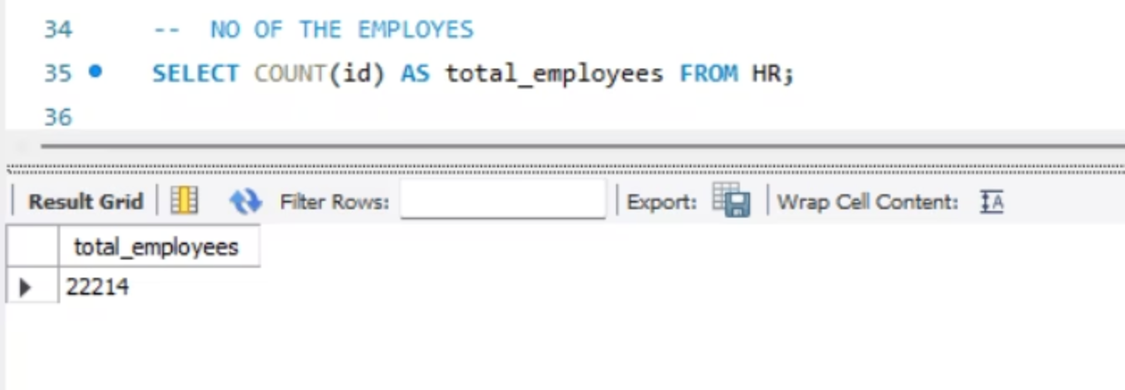
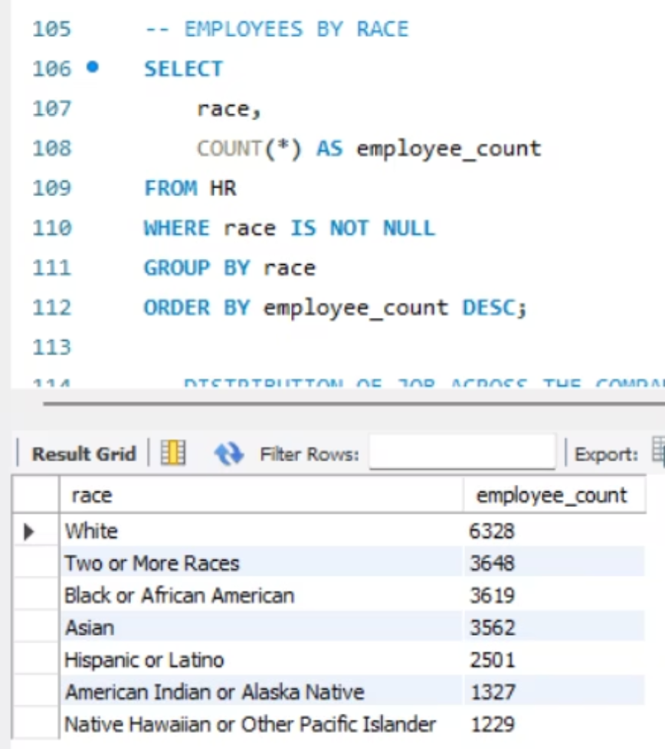
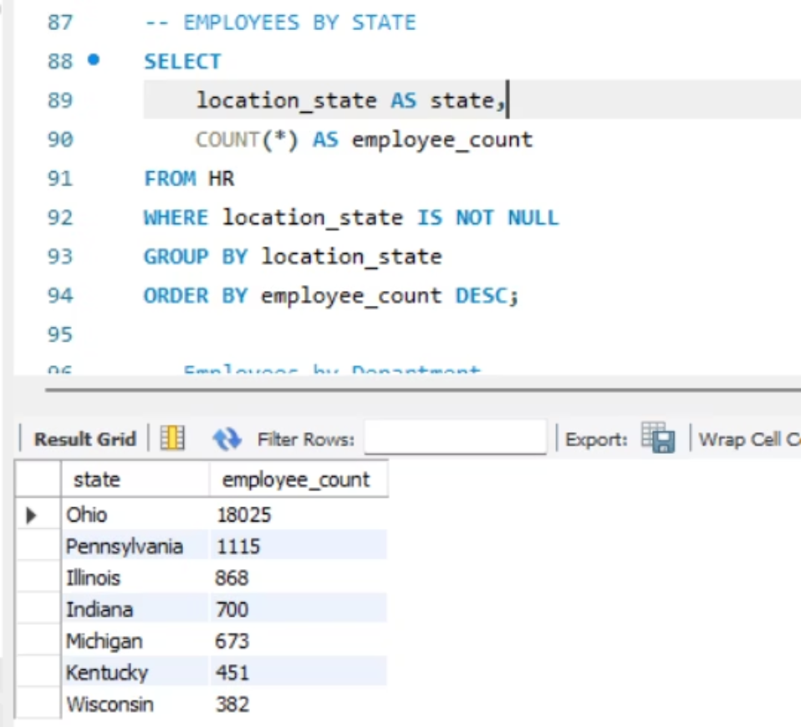
Key Outputs - Part 1

Slide 5
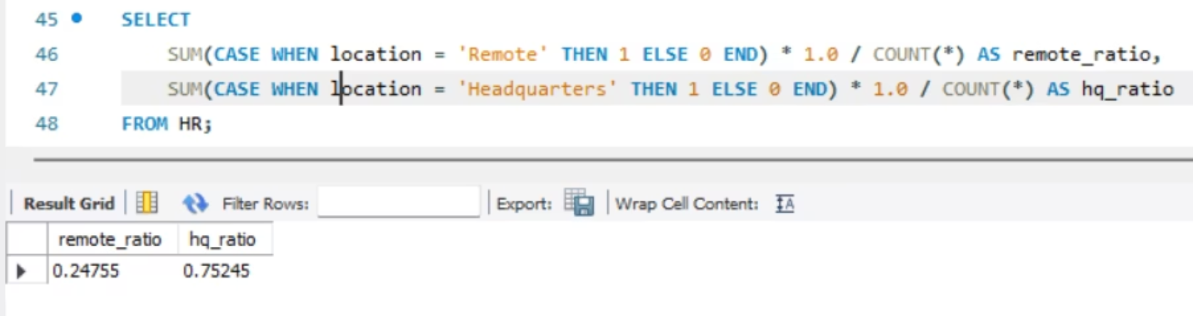
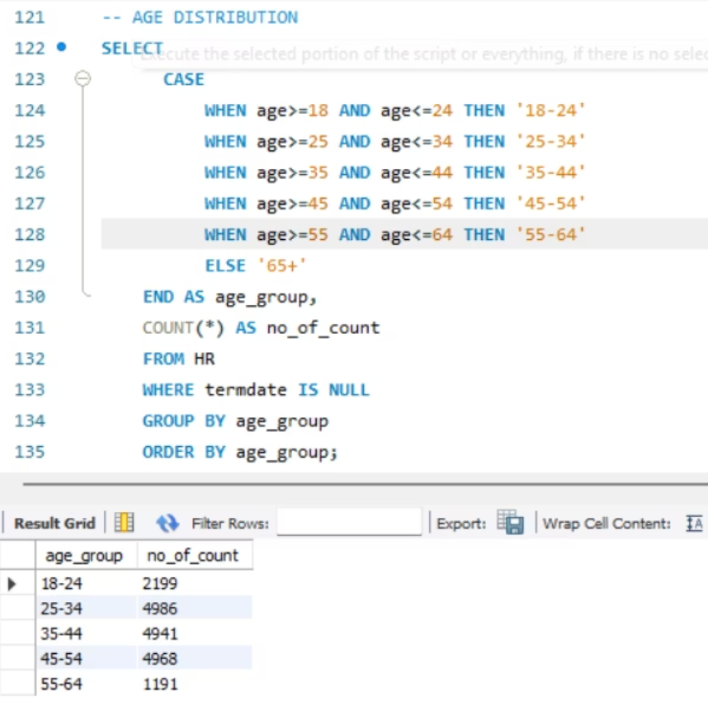
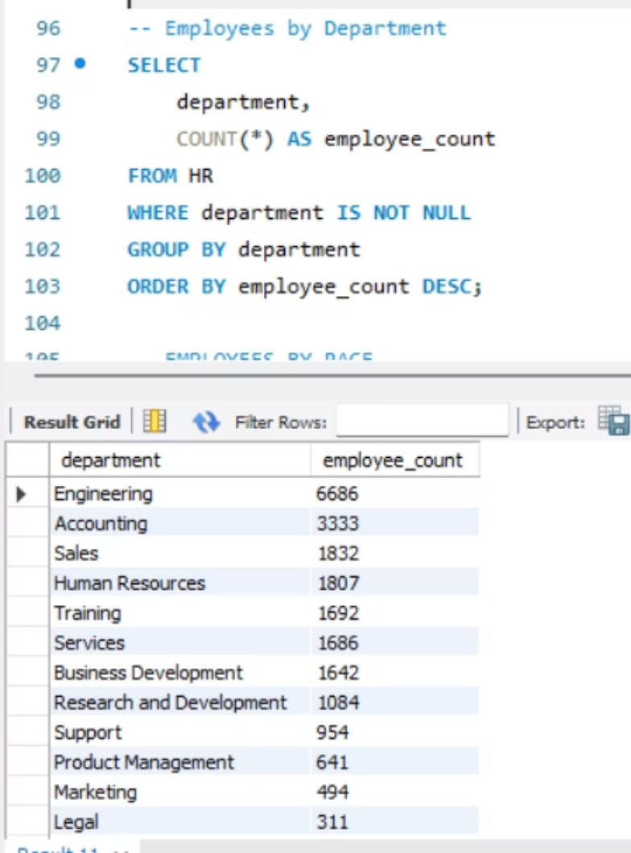
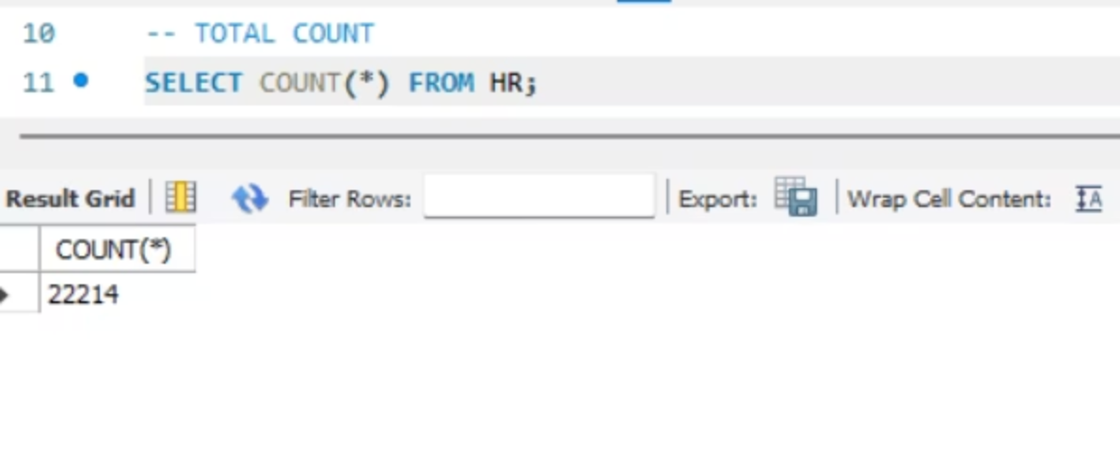
Key Outputs - Part 2

Slide 6
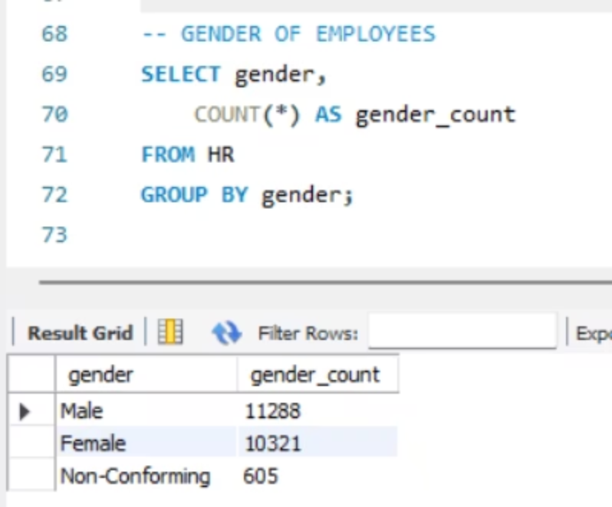
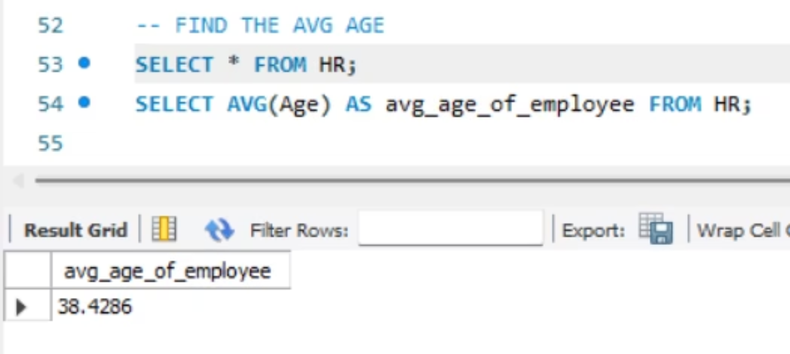
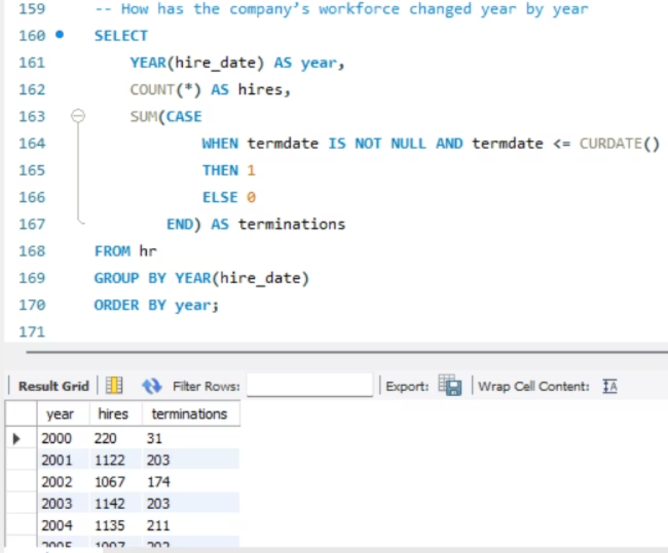
Key Outputs - Part 3

Slide 7
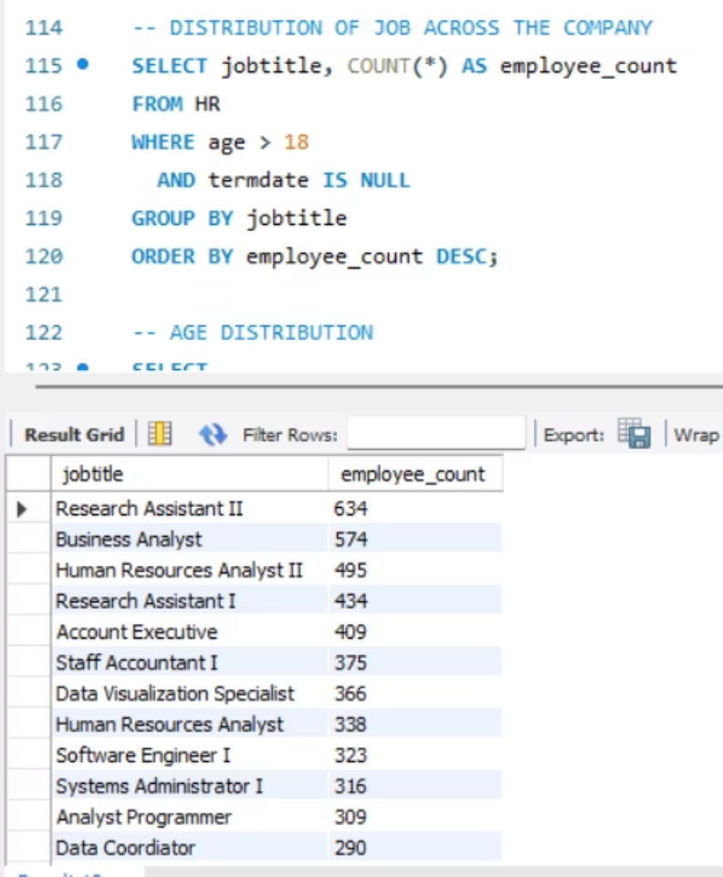
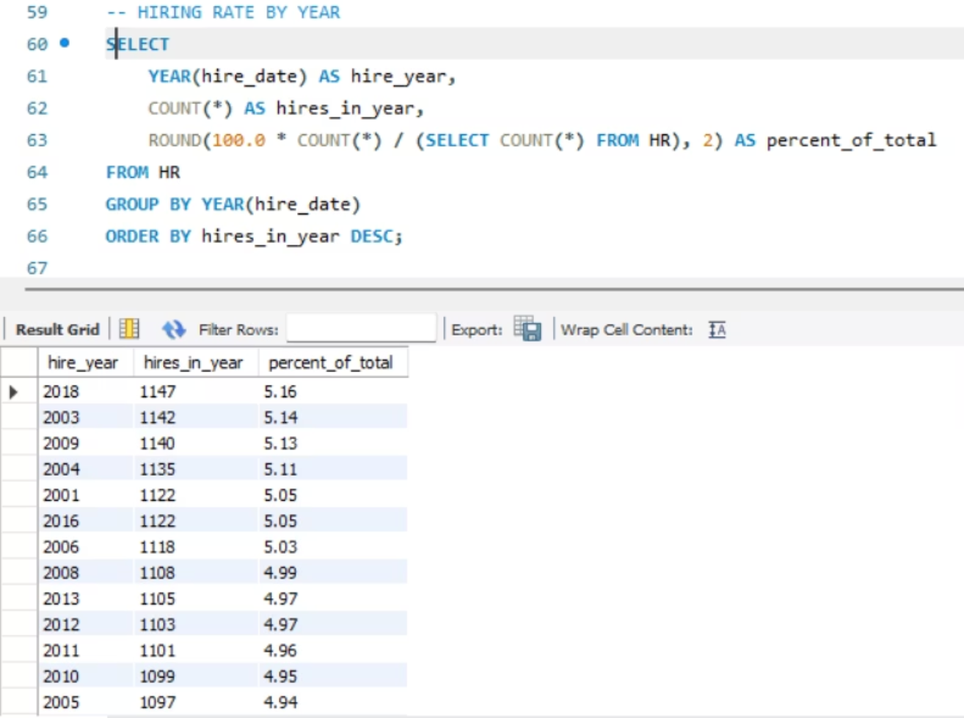
Key Outputs - Part 4

